Slide 1

Real-Time Conflict Escalation Detection
Fidelis Ambrose Mahila Lnu, Cameron Bendalin, Gabriela Garcia Gonzalez, Emily Tellschow, Rebecca Yoder
Unstructured & Distributed Data
Spring 2026

Slide 2
Contents
Statement of Problem
Challenges
Data Source Information
Initial Conclusions
Initial Code Implementation
Next Steps
01
04
02
05
03
06
Notes:
Statement of problem - Emily
Data - Becca
Code - Fidelis
Challenges - Cameron
Next steps - Gaby

Slide 3
How can more current information be provided?
Global crises are fast-moving
Information can be left out
Formal reports cannot be written and published fast enough to provide up-to-date information on where to send supplies and staff.
The internet contains vast amounts of information on what is currently happening in crisis zones through social media and news articles, which is currently underutilized when considering where to dispatch aid.

Slide 4

Problem Statement
Organizations struggle to monitor global conflict in real time with existing tools, leading to delays in transmission of information.
Global conflict data is generated continuously and at high volume
Traditional batch systems fail to capture real-time changes
Organizations lack tools to monitor conflict intensity and trends dynamically

Slide 5

The Solution
Analyze open source news data to detect shifts in intensity with the goal of providing earlier warnings and quicker updates than traditional situation reports.

Slide 6

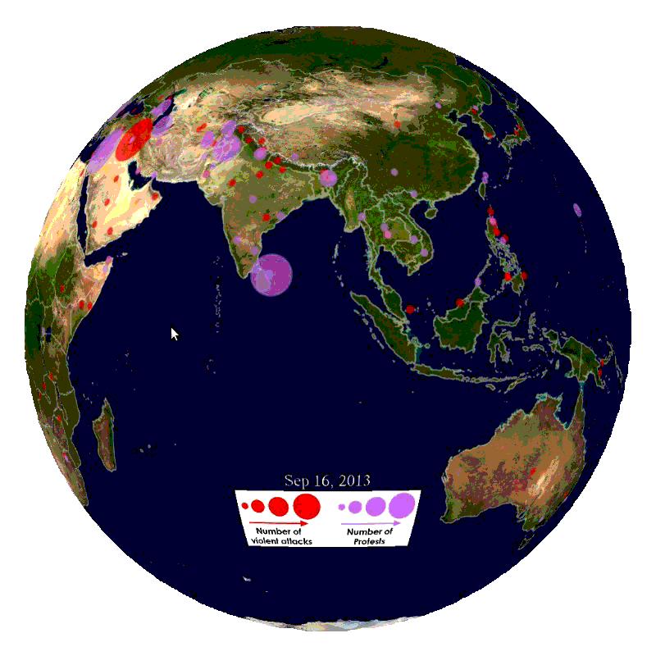
The Data
https://www.gdeltproject.org/
The GDELT Project (Global Database of Events, Language, and Tone) is a real-time open-data platform that monitors the world’s news media across broadcast, print, and web sources in over 100 languages.
Each record represents a single news-reported event between two actors
Updated every 15 minutes, 24/7
Covers events from 1979 to present
Structured using the CAMEO (Conflict and Mediation Event Observations) coding framework
Notes:
"So what data are we actually analyzing to achieve this? That's where GDELT comes in. The Global Database of Events, Language, and Tone is an open-data platform that monitors news media across broadcast, print, and web sources in over 100 languages. Every 15 minutes, 24/7, it publishes new structured event records going all the way back to 1979. Each record represents a single news-reported interaction between two actors — a government, a military, an organization — coded using a standardized conflict classification system. What makes GDELT uniquely suited for our project is that there's no scraping, no API limits, and the data arrives pre-structured and ready to process."

Slide 7
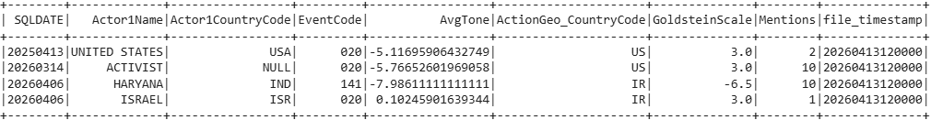
Key Columns
Event Code
Type of Event (armed assault, ceasefire)
ActionGeo
Country
Where the event took place
AvgTone
Sentiment of news coverage
Lower = more negative sentiment
Goldstein Scale
Stability rating from -10 to + 10
Mentions
How widely the event was reported across sources
Notes:
As for the actual features, GDELT is rich with data - almost to a fault. The database has over 50 columns per record, but we focus on just a few with high impact. For example, EventCode tells us what kind of event occurred — an armed assault, a ceasefire, a protest. ActionGeo Country tells us where the event actually happened. AvgTone captures the sentiment of the news coverage around that event, specifically looking at the language used. The Goldstein Scale is a theoretical measure of how destabilizing or cooperative an event type is — independently of how it's being covered. It ranges from negative 10, for the most destabilizing actions like military attacks, to positive 10 for cooperative gestures like peace agreements. To note, GDELT pre-processes each record before publishing — Goldstein scores are fixed values from the CAMEO academic framework, while AvgTone is computed automatically by GDELT's own NLP pipeline on the source articles. And finally, Mentions tells us how widely reported the event was — giving us a sense of significance to the event.

Slide 8
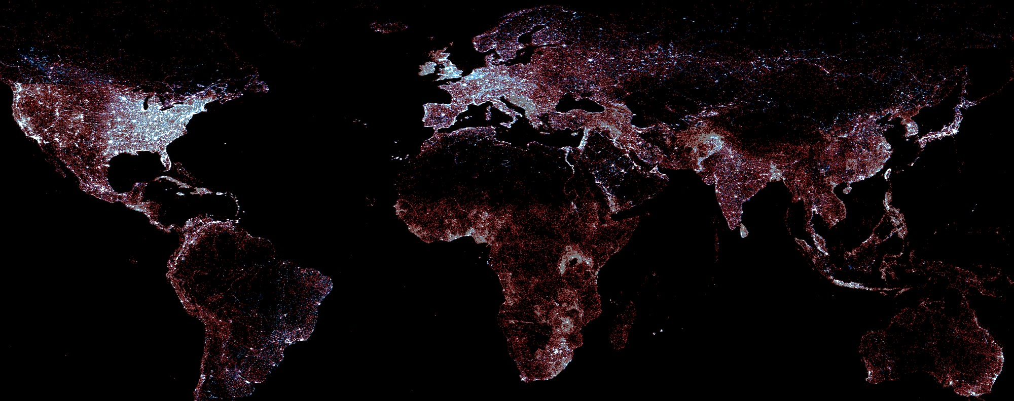
Distress Classification Logic
AvgTone
Classification
We use AvgTone to automatically classify each incoming event into one of three tiers. In our observed streaming window:
31.2% were classified as STABLE
26.1% were classified as MONITORED
42.7% of events were classified as CRITICAL
Stable - Neutral or positive tone; no immediate concern
Above -1
Monitored Event - Elevated tension; situation requires tracking
-3 to -1
Critical - Severe negative tone; likely active conflict or escalating crisis
Below -3
Notes:
"To turn this raw data into meaningful information, we use AvgTone to automatically classify every incoming event into one of three tiers. As there is no single standard for classification, we created thresholds. Above negative 1 is Stable, meaning no immediate concern. Between negative 3 and negative 1 is a Monitored Event with elevated tension worth tracking. Below negative 3 is Critical, indicating severe negative sentiment suggesting likely active conflict. To illustrate the class distribution in our observed streaming window, 31% were classified as stable, 26% were classified as Monitored, and 43% of ingested events were classified as Critical. To understand more about the code itself, I will pass it on to [teammate]."

Slide 9
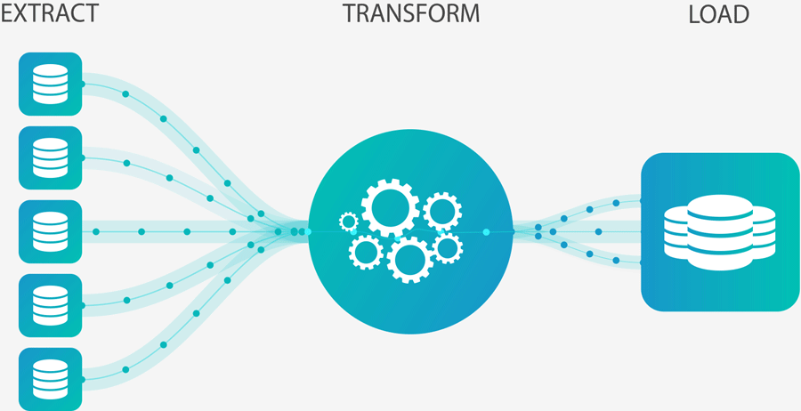
System Architecture
Stream Processing layer
Ingestion layer
Descriptive analytics
Setup & Stream
Sanity Check
Running aggregate
Event time windows
Final results
Notes:
“This slide shows the overall architecture of our real-time streaming pipeline. We designed it in three main layers: ingestion, stream processing, and analytics output.”
👉 Then quickly walk:
Ingestion layer → data comes from GDELT
Stream processing → Spark processes data in real time
Analytics layer → dashboards + results
👉 End with:
“The goal was to move from static reports to continuous, real-time monitoring.”

Slide 10
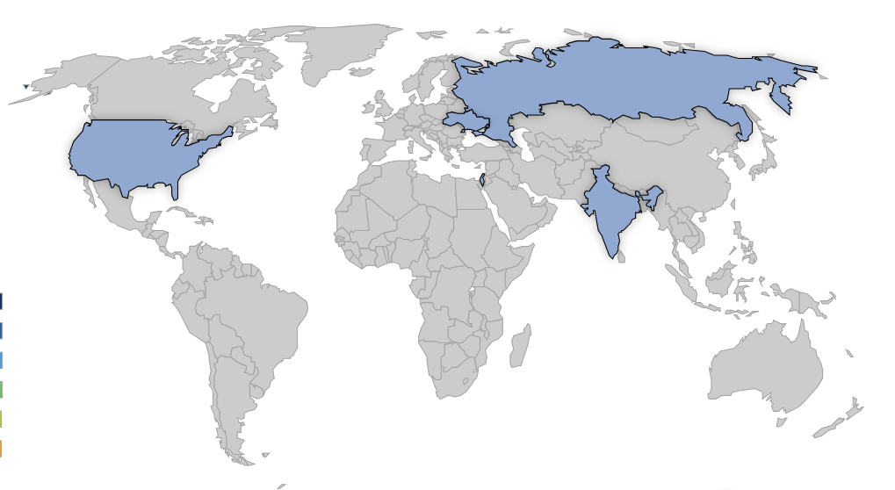
Ingestion layer
Ingestion Layer
How data moves from the internet into the system.
Automated Fetching:
import requests → HTTP requests to the GDELT project server
r = requests.get("http://data.gdeltproject.org/gdeltv2/lastupdate.txt")
Preprocessing & Filtering: Implements a CONFLICT_COUNTRIES dictionary (UK, RS, IS, GZ, US, IN) to filter raw global data locally.
Stream Triggering: Files are saved with a FORCE_ prefix in the /gdelt_stream directory.
Notes:
2.allowing our code to always download the newest available data
3.This ensures Spark Structured Streaming recognizes them as new events even if the GDELT timestamp is identical.

Slide 11

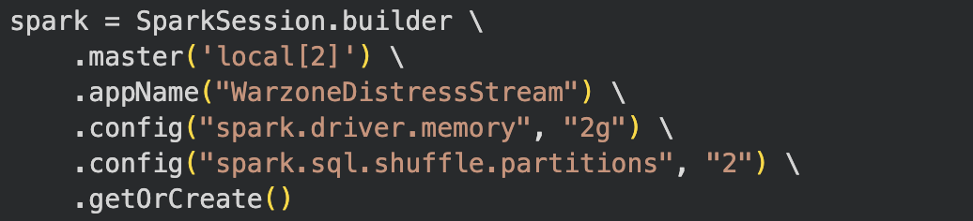
Processor code
1.Setup & Stream (The Infrastructure)
Spark Session Config:
local[2] →using 2 CPU cores
Spark.driver.memory→ 2 Gigabytes
spark.sql.shuffle.partitions = 2 to optimize performance for small, high-frequency data streams.
try_cast: Stream Reliability, preventing the monitor from going offline if GDELT sends a single malformed record.
The Classifier: The classify_distress UDF that translates raw Tone values into "CRITICAL," "MONITORED," or "STABLE" statuses.
Notes:
In Spark Structured Streaming, you typically need at least two threads:
Thread 1 (Receiver/Manager): To stay active and "listen" for new files arriving in your gdelt_stream folder.
Thread 2 (Processor): To actually run the code, calculate the Tone, and apply the UDF.
brain-space available to your Spark program-2GB is the "sweet spot" for a local project. It is large enough to prevent OutOfMemory (OOM) Errors during a heavy conflict spike (like a high-volume news day) but small enough to run on a standard laptop
y default, Spark sets this to 200. This means every time you perform a .groupBy() (like counting events by country), Spark tries to split the data into 200 tiny pieces.
Overhead: Because you are processing small 15-minute batches from GDELT, creating 200 tasks would create massive "scheduling overhead." Spark would spend more time managing the tasks than actually doing the math.
Alignment: Setting this to 2 aligns perfectly with your local[2] setting. It ensures that both CPU cores stay busy with one partition each, making the "Running Aggregates" and "Windowing" steps significantly faster.
cast — Converting to the Correct Data Type
try_ prefix? (The "Safety Net")
Fault Tolerance: If the 35th column happens to be a random piece of text instead of a number, try_cast will return NULL instead of crashing the program.
Data Cleaning: It automatically filters out "garbage" data. You can later use .na.drop() or .fillna() to handle those null values, ensuring your "Critical Distress" averages aren't skewed by corrupt data points.

Slide 12

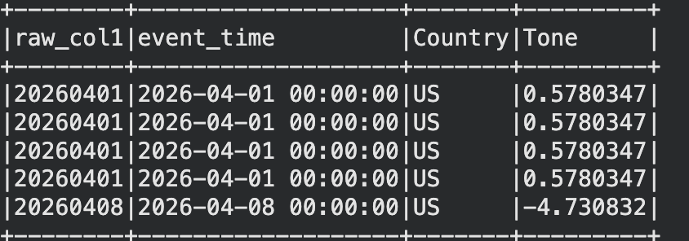
Processor code
2.Data Quality Assurance
Static vs. Stream: Static Read of the stream path before starting the live stream to ensure the parser works.
Validation Metrics: The code checks for null_count in timestamps and calculates the earliest_event and latest_event to verify time-parsing accuracy.

Slide 13
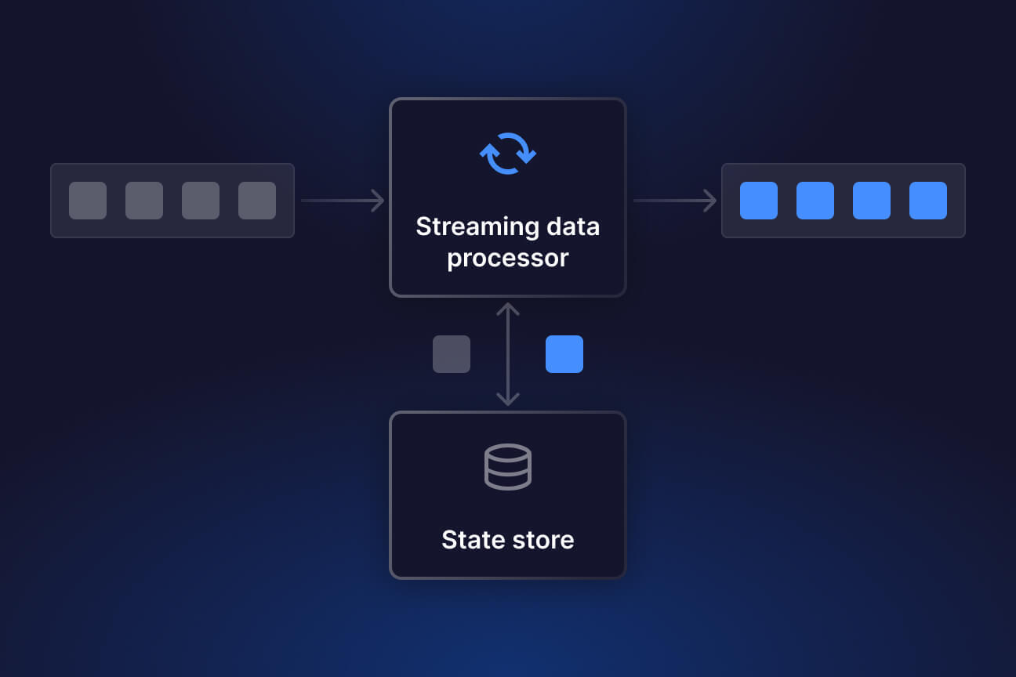
Processor code
3.Real-Time Analytical Aggregations
Global Pulse: Total count of events by DistressStatus.
Country Intensity: avg(Tone) and avg(Goldstein) per nation.
Drill-Down: Intersection of Country + DistressStatus.
outputMode('complete')-This ensures our dashboard always displays the most up-to-date cumulative totals.
Memory Sink- for a real-time monitor It allows us to store the results in RAM.

Slide 14
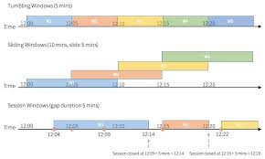
Processor code
4.Event Time Windows
Tumbling Windows: Fixed 2-hour blocks used to count events per country without overlap.
Sliding Windows: 2-hour windows sliding every 1 hour to detect rapid shifts in conflict intensity.
Watermarking: Implementation of a 2-hour Watermark to manage late-arriving data and clean up old state from memory.

Slide 15

Processor code
5.Output
File Name (.csv) | Functional Role
final_distress_totals | Global Severity Index
final_country_totals | Geopolitical Heatmap
final_country_breakdown | Regional Drill-down
final_event_window | Chronological Volume
final_event_sliding | Momentum Tracker
final_event_distress | Temporal Crisis Deep-Dive

Slide 16
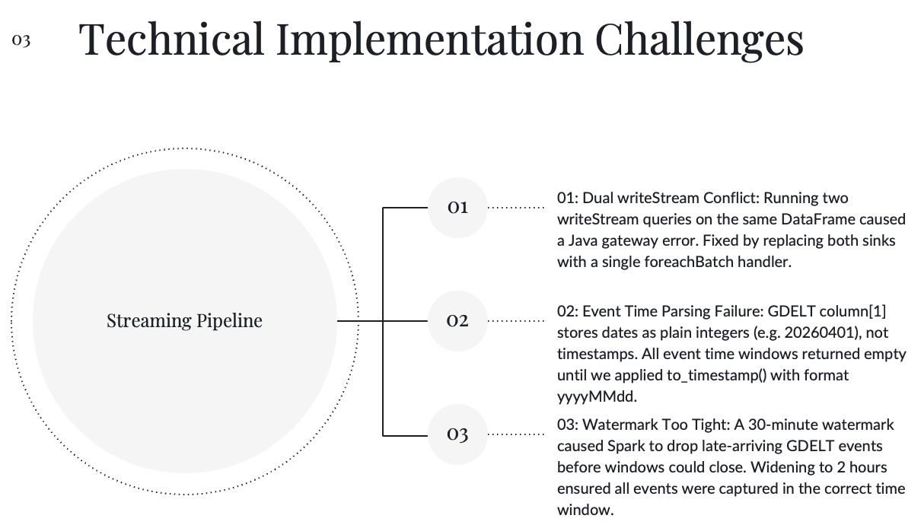

Slide 17
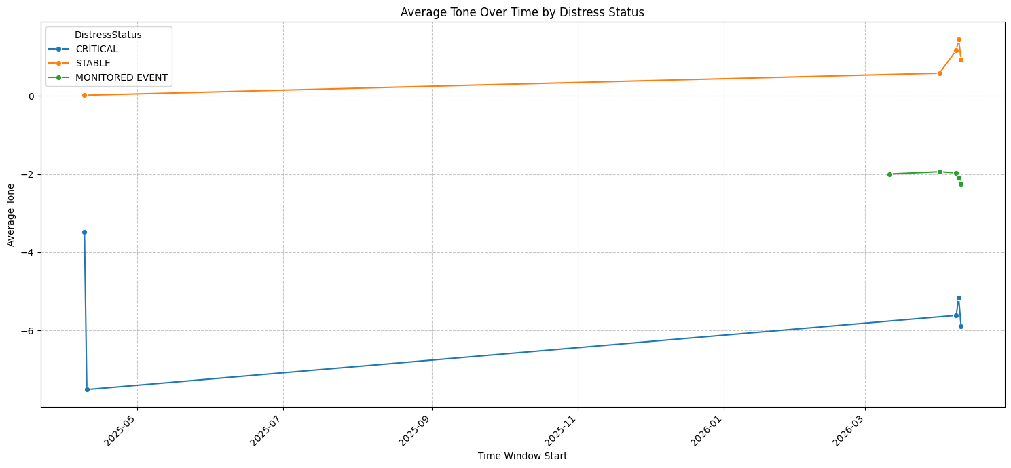
Visualizations

Slide 18
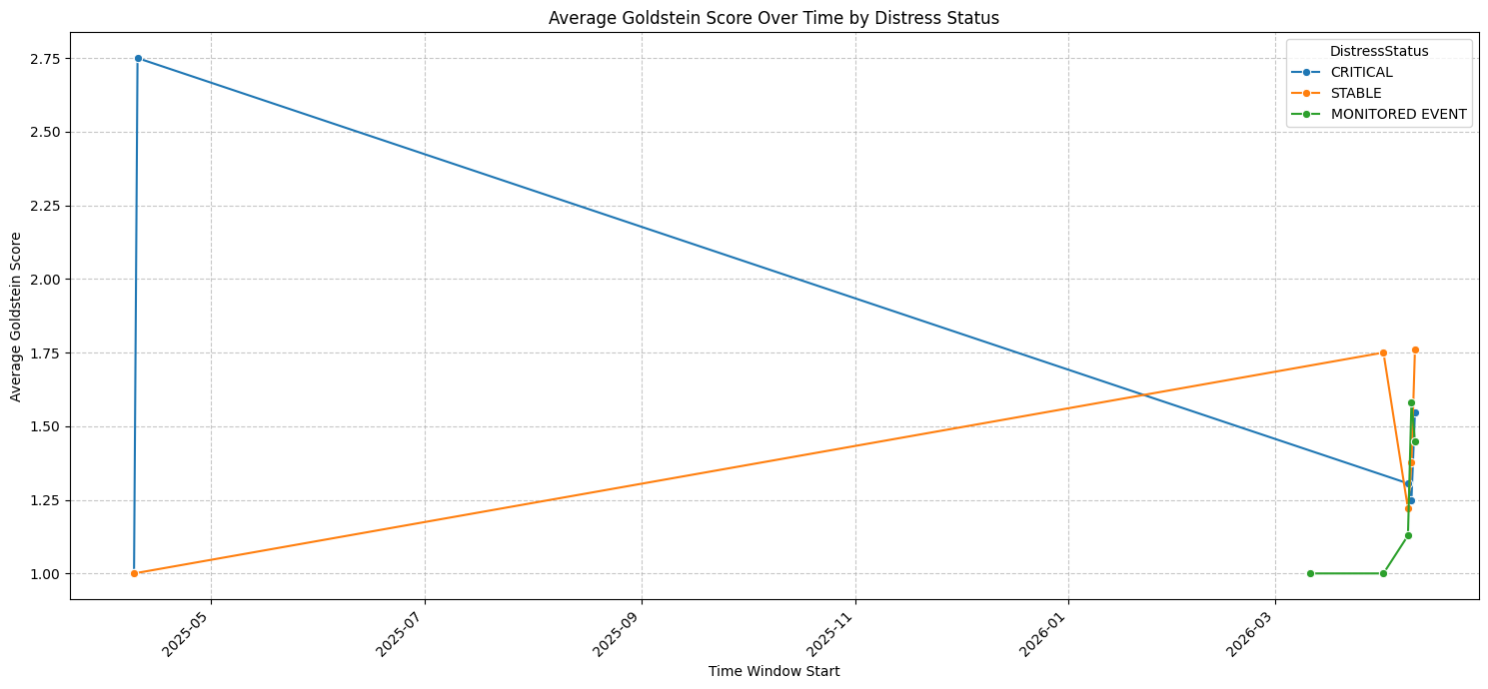
Visualizations

Slide 19
Facing the Challenges Ahead
Data Quality and Noise
Real-Time Processing
Defining Escalation
Duplicate reporting across multiple news sources inflates event counts
Media bias leads to overreporting in some regions and underreporting in others
Sentiment/tone scores may not accurately reflect actual conflict severity
GDELT updates every 15 minutes, requiring near real-time ingestion
Data may arrive out of order, incomplete, or delayed across regions
Maintaining consistent state across rolling time windows is complex
No universal definition of conflict escalation
Is escalation driven by volume, severity, tone, or geographic spread?
Raw event counts may reflect media attention rather than actual instability

Slide 20
Conclusions
Tone below -3 as threshold on critical situations:
Converts high-volume, continuous GDELT data into a simple, actionable intensity signal.
Reduces information lag compared to traditional batch reporting.
Streaming pipeline closes the monitoring gap:
Process global conflict data dynamically as it is generated.
Replaces slow, periodic updates with continuous trend detection.
Limitations:
This indicator provides a signal that a situation is escalating - not how the region is going to be impacted.
The bottom line is that this provides a scalable, near real-time conflict monitoring tool that gives organizations earlier visibility into escalating situations - closing the information gap that traditional systems cannot address.

Slide 21
Potential Next Steps
Expand regional coverage:
Apply the pipeline to additional active conflict zones to validate the tone threshold across different conflict types and geographies.
Enhance the escalation model:
Incorporate additional GDELT fields — such as actor types— to improve signal granularity beyond tone.
Integrate external validation sources:
Cross-reference escalation flags with UN situation reports, ACLED, or OCHA bulletins to benchmark detection accuracy.

Slide 22
Potential Next Steps cont.
Test on a current active conflict:
Apply the pipeline to an ongoing conflict in real time to assess whether GDELT's live data stream provides enough granularity to detect operationally meaningful shifts.
Evaluate whether the richness of the live stream differs from historical snapshots in ways that improve or limit the indicator's usefulness.
Assess CAMEO codes and actor fields for operational decision support:
Analyze whether sequences of CAMEO event codes and actor metadata can bridge the gap between escalation detection and deployment decisions.
Focus on escalation chains where diplomatic or economic pressure precedes kinetic conflict — for example, code 135 (Threaten with sanctions) escalating to code 165 (Impose economic sanctions) — as potential precursors to humanitarian need.

Slide 23

Thank you!

